Slide 1

KRTA 2021 Board Presentation
July11, 2022
Mike Lewis – Regional Vice President

Slide 2
KRTA
Key Ratio Trend Analysis
  812 Coops
  Groupings (National, State, Consumer Size, Power Supply Group, Plant Growth)
Benchmarking tool
You’ve seen one coop, you’ve seen one coop!
Look for trends
Look for unusual or unexpected variances

Slide 3



Peer Group Comparison
United States
812
Kansas
25
Power Supplier Sunflower
6
What You Can’t Do
Answer why ratios are high or low
Interpret financial goals
What You CAN Do
See trends and variances
Benchmark results of operations
See strengths and areas for improvement

Slide 4
Power of the KRTA
Peer Groups
  Nation
  State
  Similar Size (Consumers)
  Same Power Supply
  Similar growth
Categories
  Base Group
  Financial Ratios
  Revenue & Margins Ratios
  Sales Ratios
  Controllable Expense Ratios
  Fixed Expense Ratios
  Total Expense Ratios
  Employee Ratios
  Growth Ratios
  Plant Ratios
  145 in total

Slide 5
Median Value
KRTA uses MEDIAN values, not average, and ranks results from high to low
Average Example
  8,000
  76
  43
  8
  1
Average = 1,626
Median Example
  8,000
  76
  43
  8
  1
Median = 43
8,128 / 5 = 1,626

Slide 45
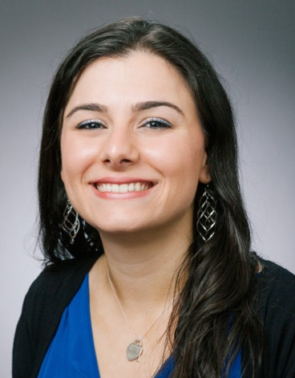
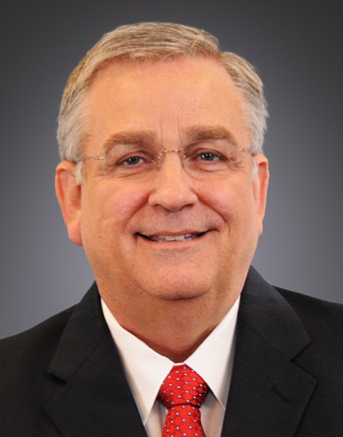
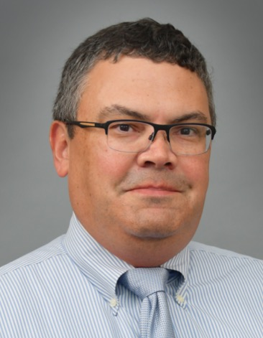
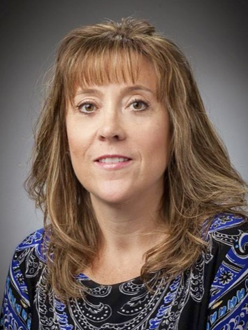
Kansas Distribution Lending Team
Joyce Germano
Associate Vice President
703-467-1753
joyce.germano@nrucfc.coop
Mike Lewis
Regional Vice President
913-416-2532
mike.lewis@nrucfc.coop
Amy Luongo
VP, Portfolio Management
703-467-1876
amy.luongo@nrucfc.coop

Slide 46

Thank you!
Questions/Discussion
Matt Augustosky Colleen Taylor Marianne Dusold Jeff Butler Jeff Kilpatrick
If you have any questions, please contact Jeff Butler at (580) 559-1772 or Jeff Kilpatrick @ (571) 232-7118

Slide 47


