Slide 1
2023
Member Satisfaction Survey Results
Conducted & compiled by Inside Information® Inc.

Slide 2
During the spring of 2023, Lane-Scott Electric Cooperative conducted a member satisfaction survey. From a randomly selected sample of all residential members, 251 surveys were completed online and by phone, yielding a margin of error of +/-5.76% at a 95% degree of probability.
Overview

Slide 3
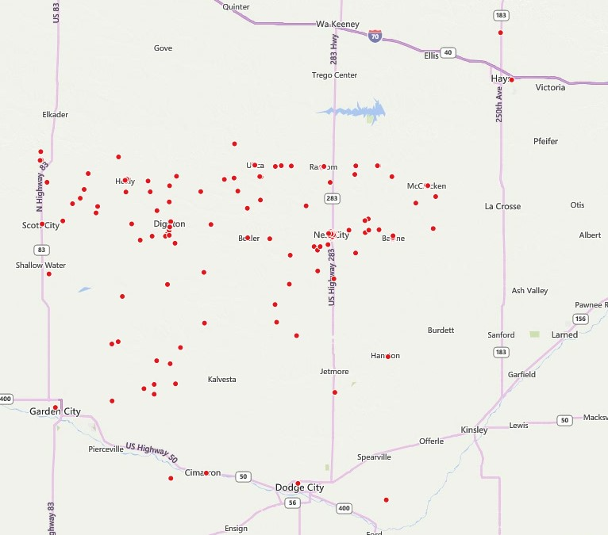
251 respondents
Survey Respondents

Slide 4
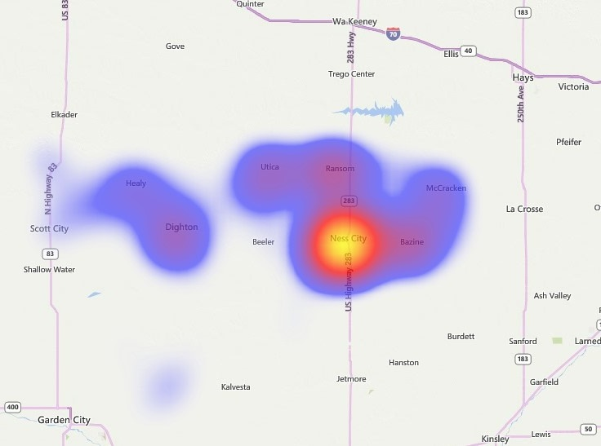
Response Density
Survey Respondents
251 respondents

Slide 5
Cooperative Attitude & Performance Score

Slide 6
Cooperative is a Trustworthy Organization
Survey | Top Box | Average
2020 | 91% | 9.3
2023 | 96% | 9.4
CAPS
1=strongly disagree, 10=strongly agree

Slide 7
Cooperative Truly Cares About its Members
Survey | Top Box | Average
2020 | 91% | 9.2
2023 | 93% | 9.3
CAPS
1=strongly disagree, 10=strongly agree

Slide 8
Cooperative is a Well-Managed Organization
Survey | Top Box | Average
2020 | 91% | 9.2
2023 | 93% | 9.3
CAPS
1=strongly disagree, 10=strongly agree

Slide 9
CAPS
93
Cooperative Attitude & Performance Score

Slide 10
Member Satisfaction – by age
Satisfaction
on 10-pt scale

Slide 11
American Customer Satisfaction Index

Slide 12
Overall Satisfaction with the Co-op
Year | Top Box | Average
2020 | 92% | 9.2
2023 | 94% | 9.2
Satisfaction
1=not at all satisfied, 10=very satisfied

Slide 13
How Well Does the Co-op Meet Your Expectations?
Top Box | Average
85% | 8.7
Satisfaction
1=falls short of expectations, 10=exceeds expectations

Slide 14
How Well Does the Co-op Compare with the Ideal Utility Company?
Top Box | Average
91% | 9.0
Satisfaction
1=not very close to ideal, 10=very close to ideal

Slide 15
Likely to Choose the Co-op Again Today?
Top Box | Average
94% | 9.2
Satisfaction
1=not at all likely, 10=very likely

Slide 16
ACSI
89
Satisfaction

Slide 17
BENCHMARKING

Slide 18
CAPS National Cooperative Comparison
Benchmarking

Slide 19
Average ACSI Score Trend Comparison
Benchmarking

Slide 20
Comparison of ACSI Scores (from ACSI)
Benchmarking
*from ACSI Cooperative Utility Sector Report

Slide 21
Inside Information Client ACSI
Benchmarking

Slide 22
PERFORMANCE

Slide 23
Electric Service and Rates
Average for all performance variables – 90%
Performance
Key ACSI or CAPS driver
Top box (8-10) responses

Slide 24
Member Service
Average for all performance variables – 90%
Performance
Key ACSI or CAPS driver
Top box (8-10) responses

Slide 25
Cooperative Culture
Average for all performance variables – 90%
Performance
Key ACSI or CAPS driver
Top box (8-10) responses

Slide 26
CAPS
ACSI
Electric Service & Rates
Key Drivers
Member Service
Cooperative Culture
Regression analysis is performed on all the performance variables to determine which variables impact the CAPS and ACSI scores.

Slide 27
Performance Trends
Performance
On a 10-pt scale

Slide 28
Communication & Technology

Slide 29
Do you view yourself as a member-owner, customer, or both?
Communication

Slide 30
Preferred Method to Pay Bill
Communication
Multiple response question

Slide 31
Preferred Method to Receive Information from Co-op (not bill or outage related)
Communication
Multiple response question

Slide 32
Preferred Contact for Power Outages
Communication
Multiple response question

Slide 33
Recent Contact with the Co-op
Communication
Multiple response question

Slide 34
Renewable Energy

Slide 35
Belief that Electricity Generated by Wind Is Reliable
Renewables

Slide 36
How beneficial is wind generation for the environment?
Top Box | Average
29% | 5.6
Renewables
1=not at all beneficial, 10=very beneficial

Slide 37
Belief that Electricity Generated by Solar Is Reliable
Renewables

Slide 38
How beneficial is solar generation for the environment?
Top Box | Mean
34% | 6.0
Renewables
1=not at all beneficial, 10=very beneficial

Slide 39
Have or Considering Installing Equipment to Generate Electricity
Renewables

Slide 40
Current Sources of Home Generation
Renewables
Multiple response question

Slide 41
Interest in Sources of Home Generation
Renewables
Multiple response question

Slide 42
Motivating Factors for Installing Renewable Energy Sources
Renewables
Multiple response question

Slide 43
Would you spend up to $20/month to purchase energy credits to support renewables?
Renewables

Slide 44
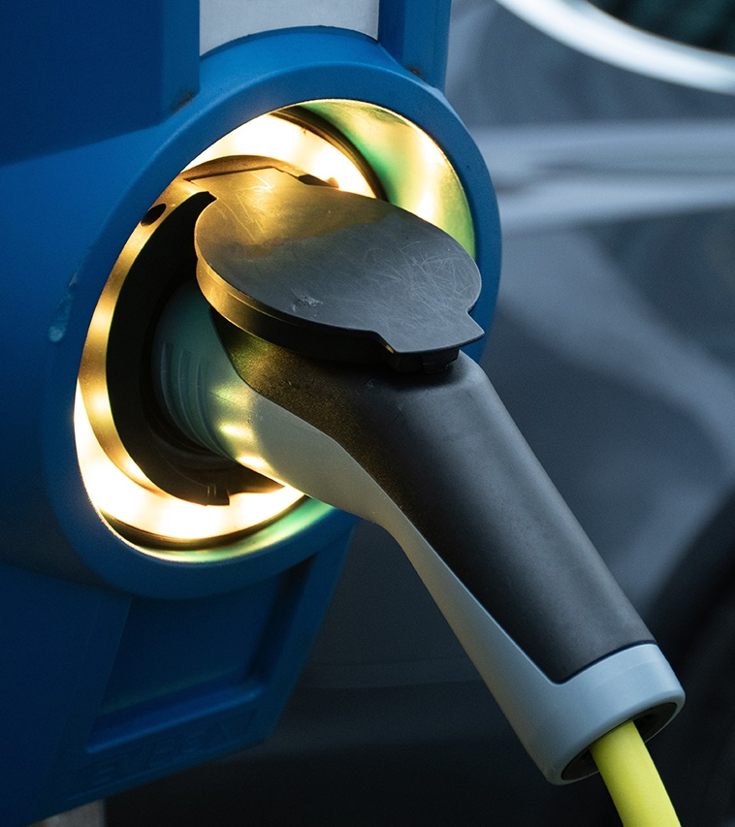
Electric Vehicles

Slide 45
Current Electric Vehicle Ownership
Electric Vehicles

Slide 46
Considering Purchasing an Electric Vehicle
Electric Vehicles

Slide 47
Do you believe electric vehicles are better for the environment?
Electric Vehicles

Slide 48
What class charger do you have or intend to install?
Electric Vehicles
*Of the 13 members who responded

Slide 49
Interest in a reduced, overnight or weekend off-peak electricity rate
Electric Vehicles
*of those who own or intend to purchase an electric vehicle

Slide 50
Concerns with Owning/Leasing an Electric Vehicle
Electric Vehicles
Multiple response question

Slide 51
Interest in Involvement of Sustainability Advisory Task Force
Electric Vehicles
40 names were collected along with contact information.

Slide 52
Demographics

Slide 53
Length of Service
Median: 22 years
Demographics

Slide 54
Respondent Age
Median: 66
Demographics

Slide 55
Education
Demographics

Slide 56
Occupation
Demographics

